Slide 1
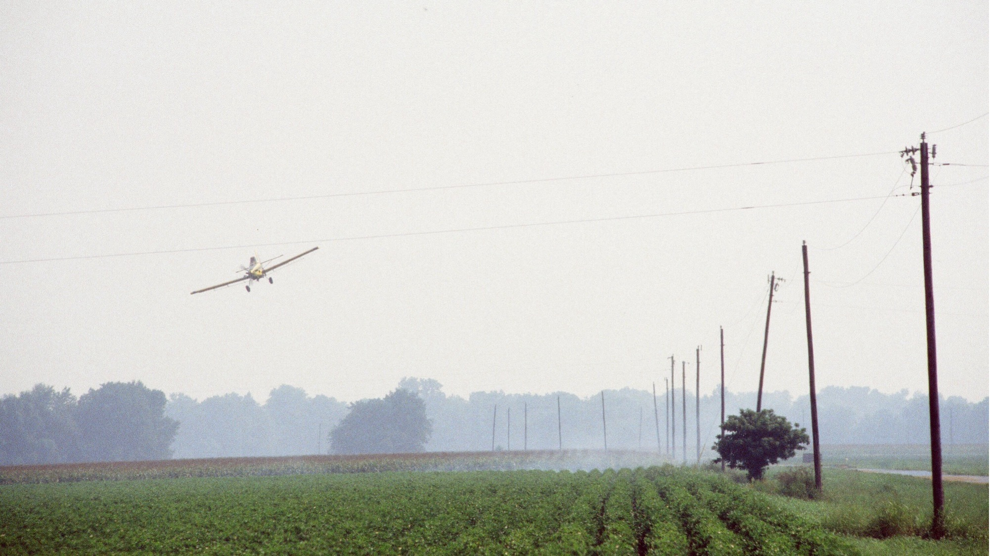


Agricultural Aviation and Wires
INSERT YOUR NAME AND CONTACT INFO HERE

Slide 2
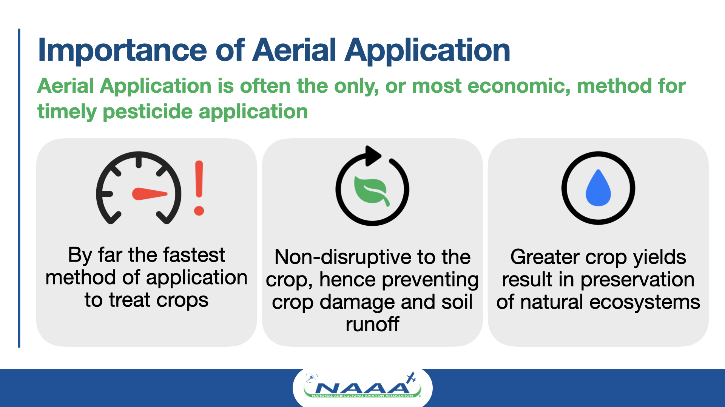

Slide 3
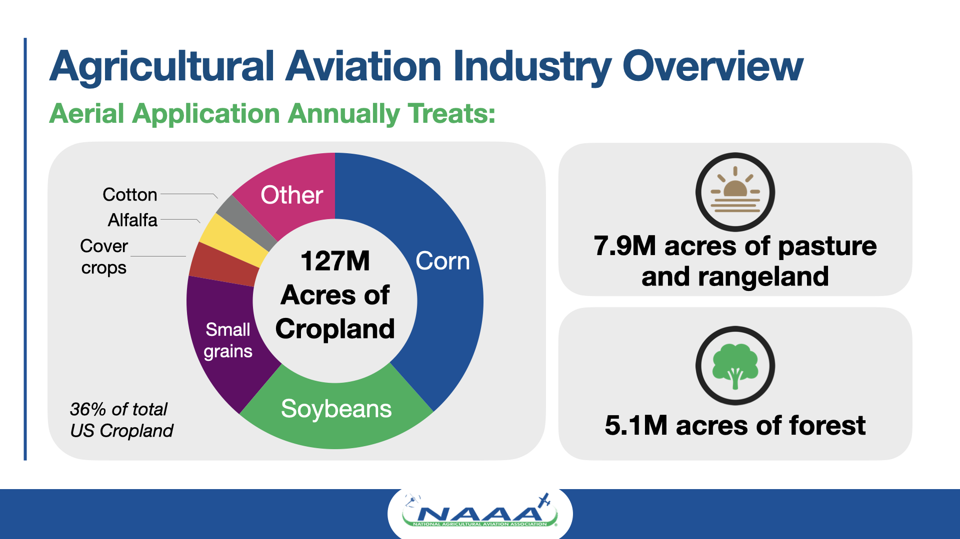

Slide 4
ENTER YOUR OPERATION NAME HERE
ENTER INFORMATION ON YOUR OPERATION HERE SUCH AS:
  CROPS TREATED
  NUMBER OF ACRES TREATED
  NUMBER OF CUSTOMERS
  FINANCIAL IMPACT TO GROWERS AND LOCAL ECONOMY

Slide 5
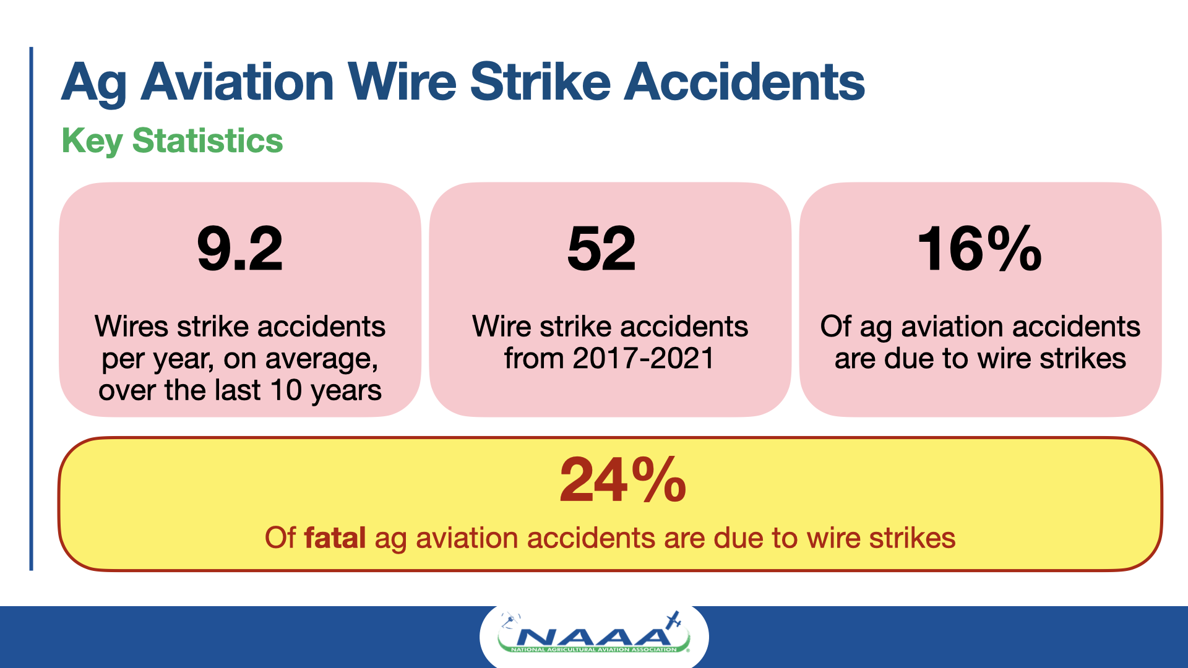

Slide 6
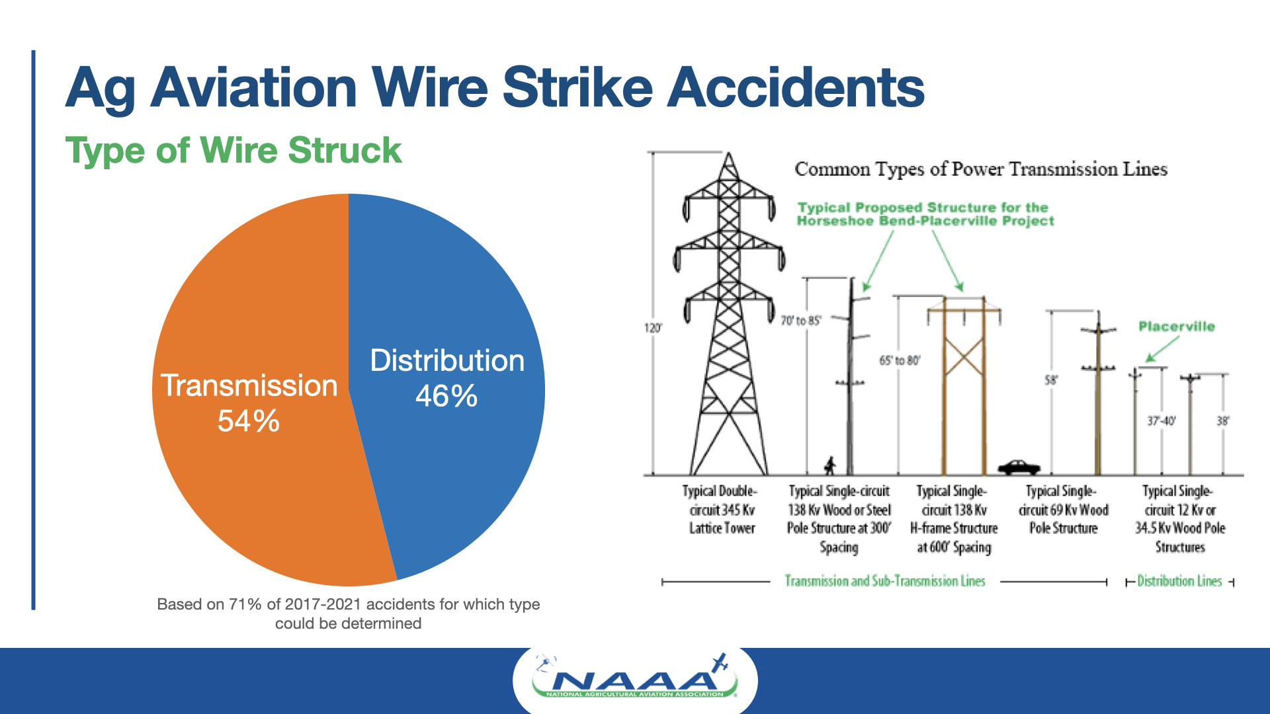

Slide 7
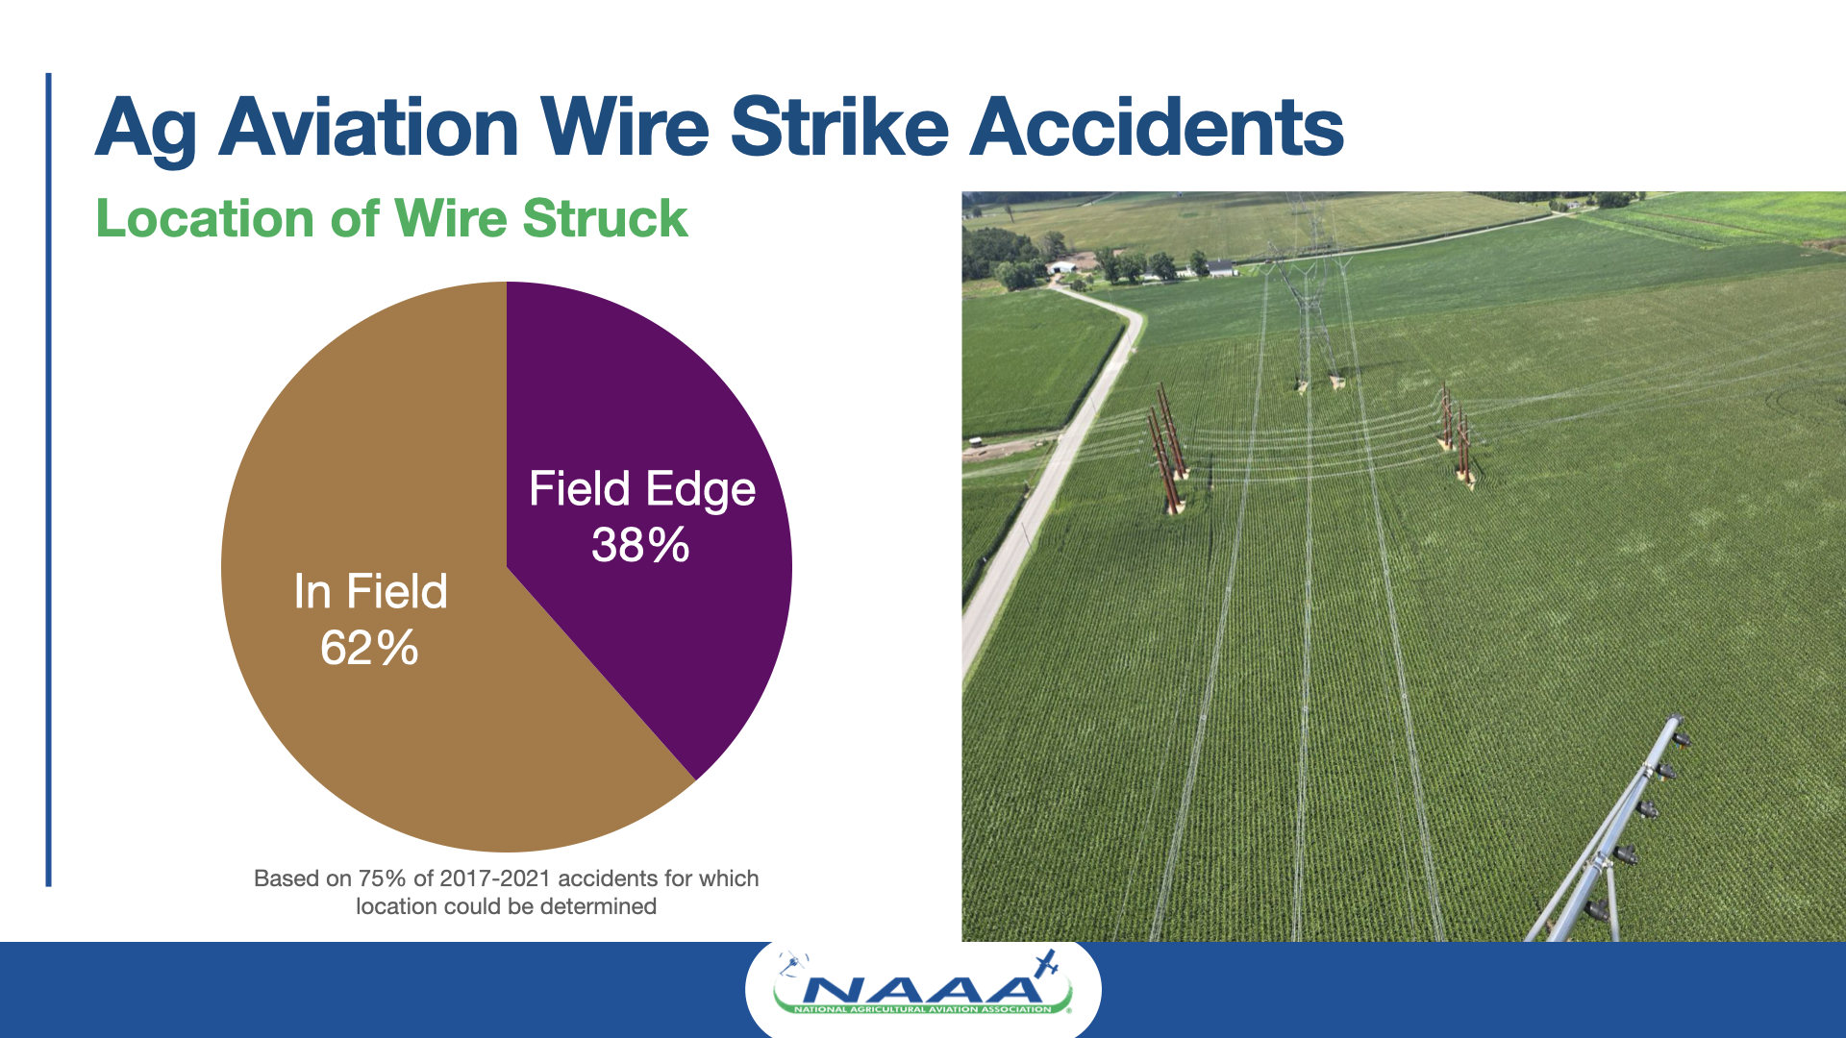

Slide 8
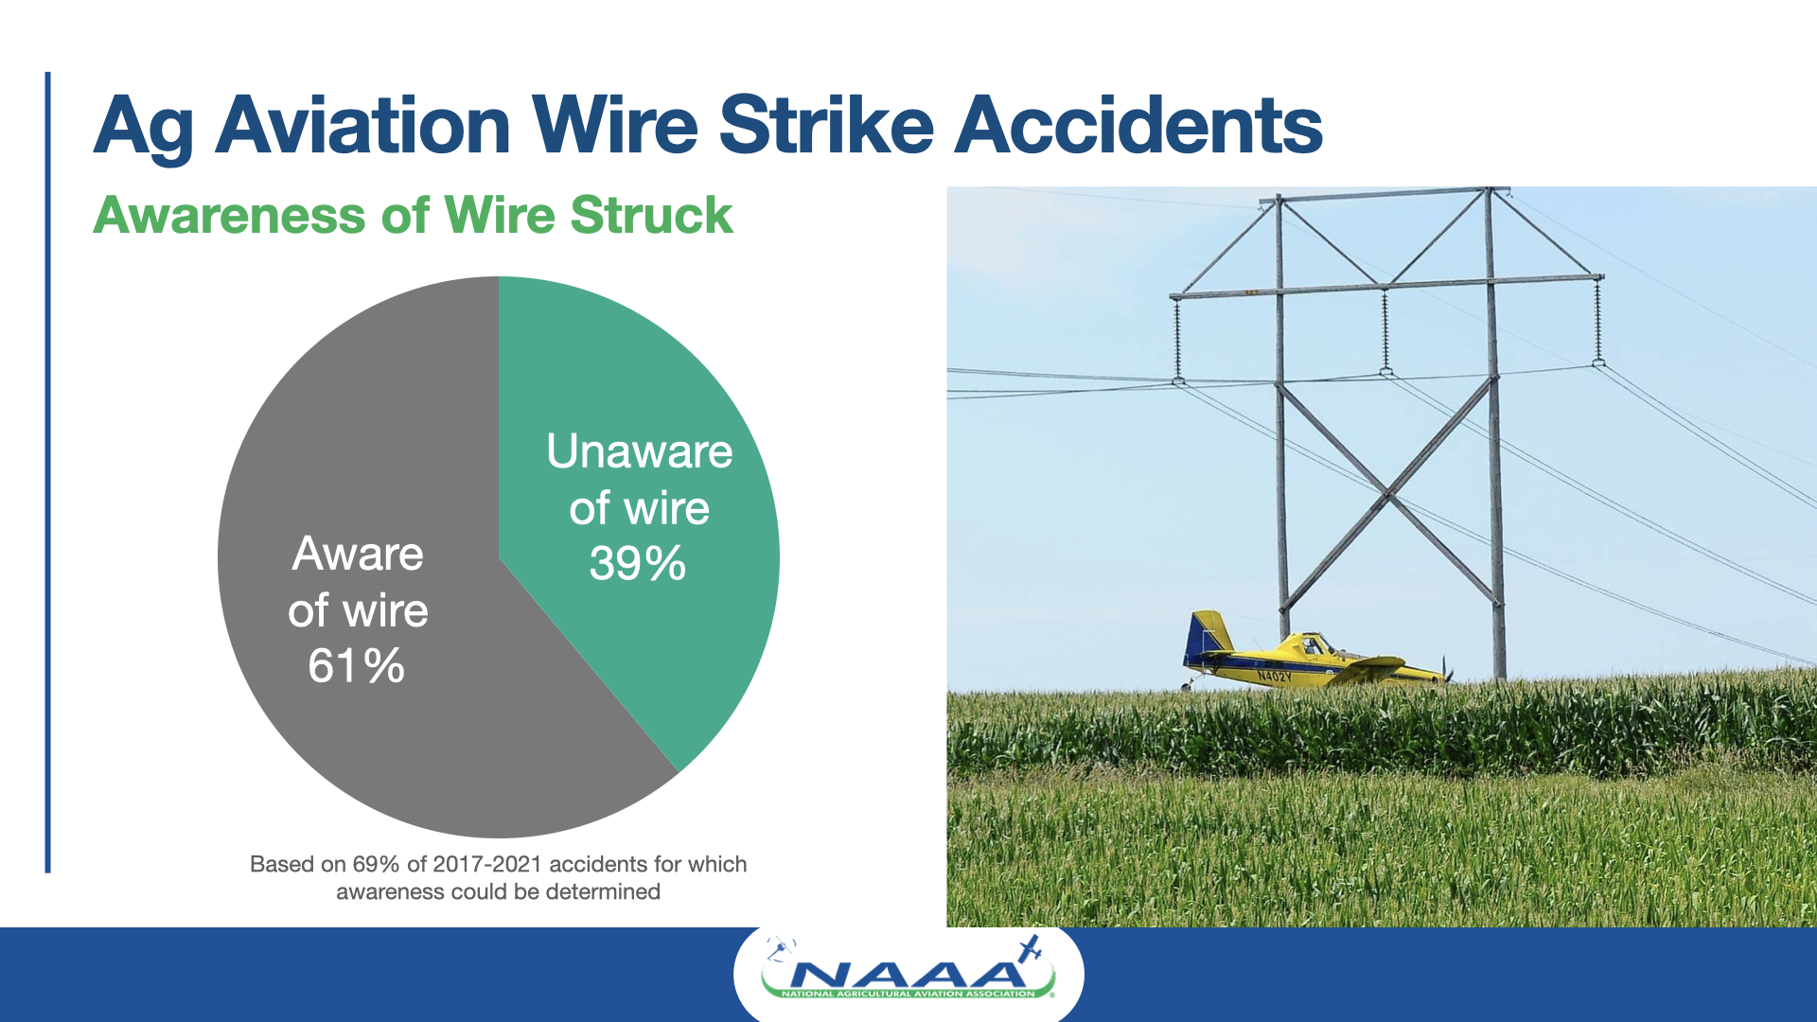

Slide 9
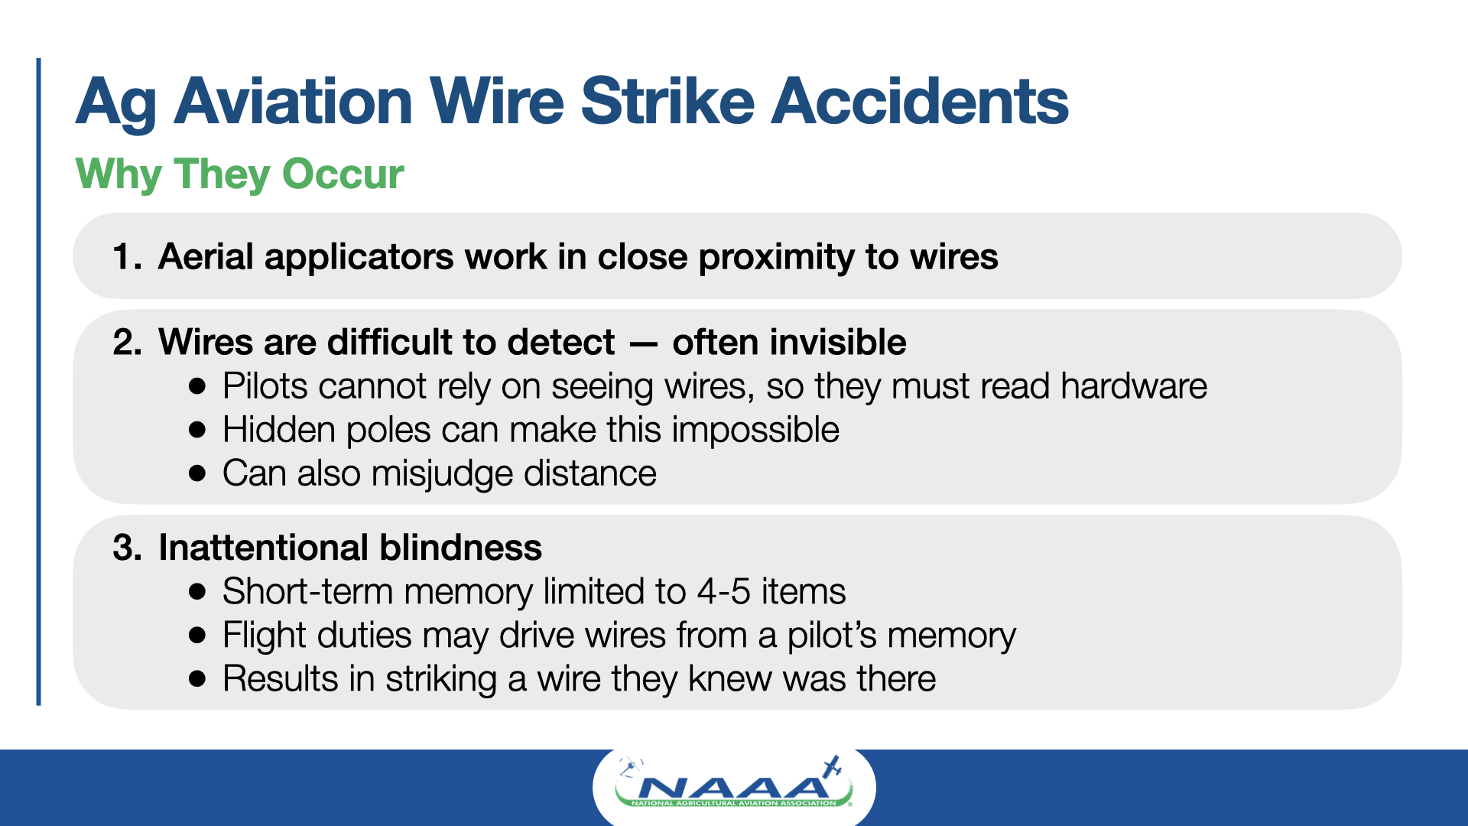

Slide 10
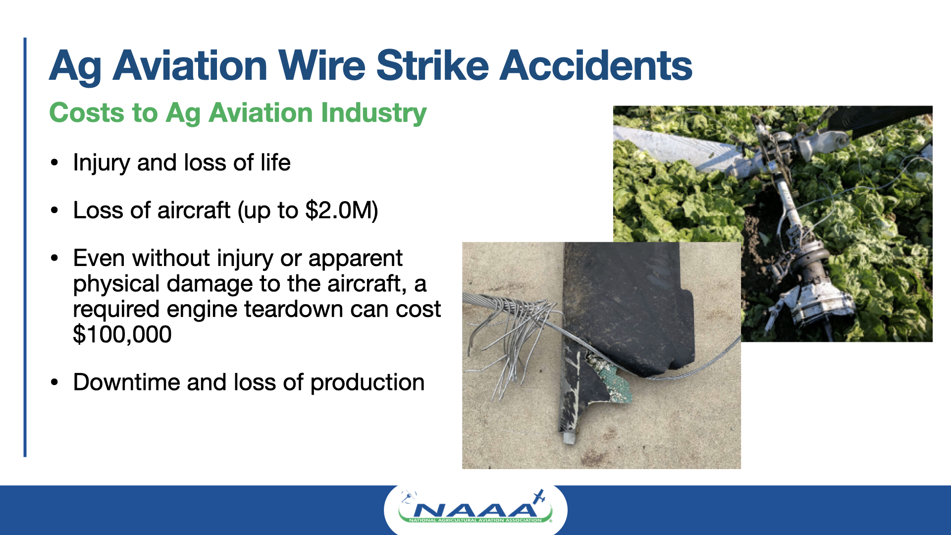

Slide 11
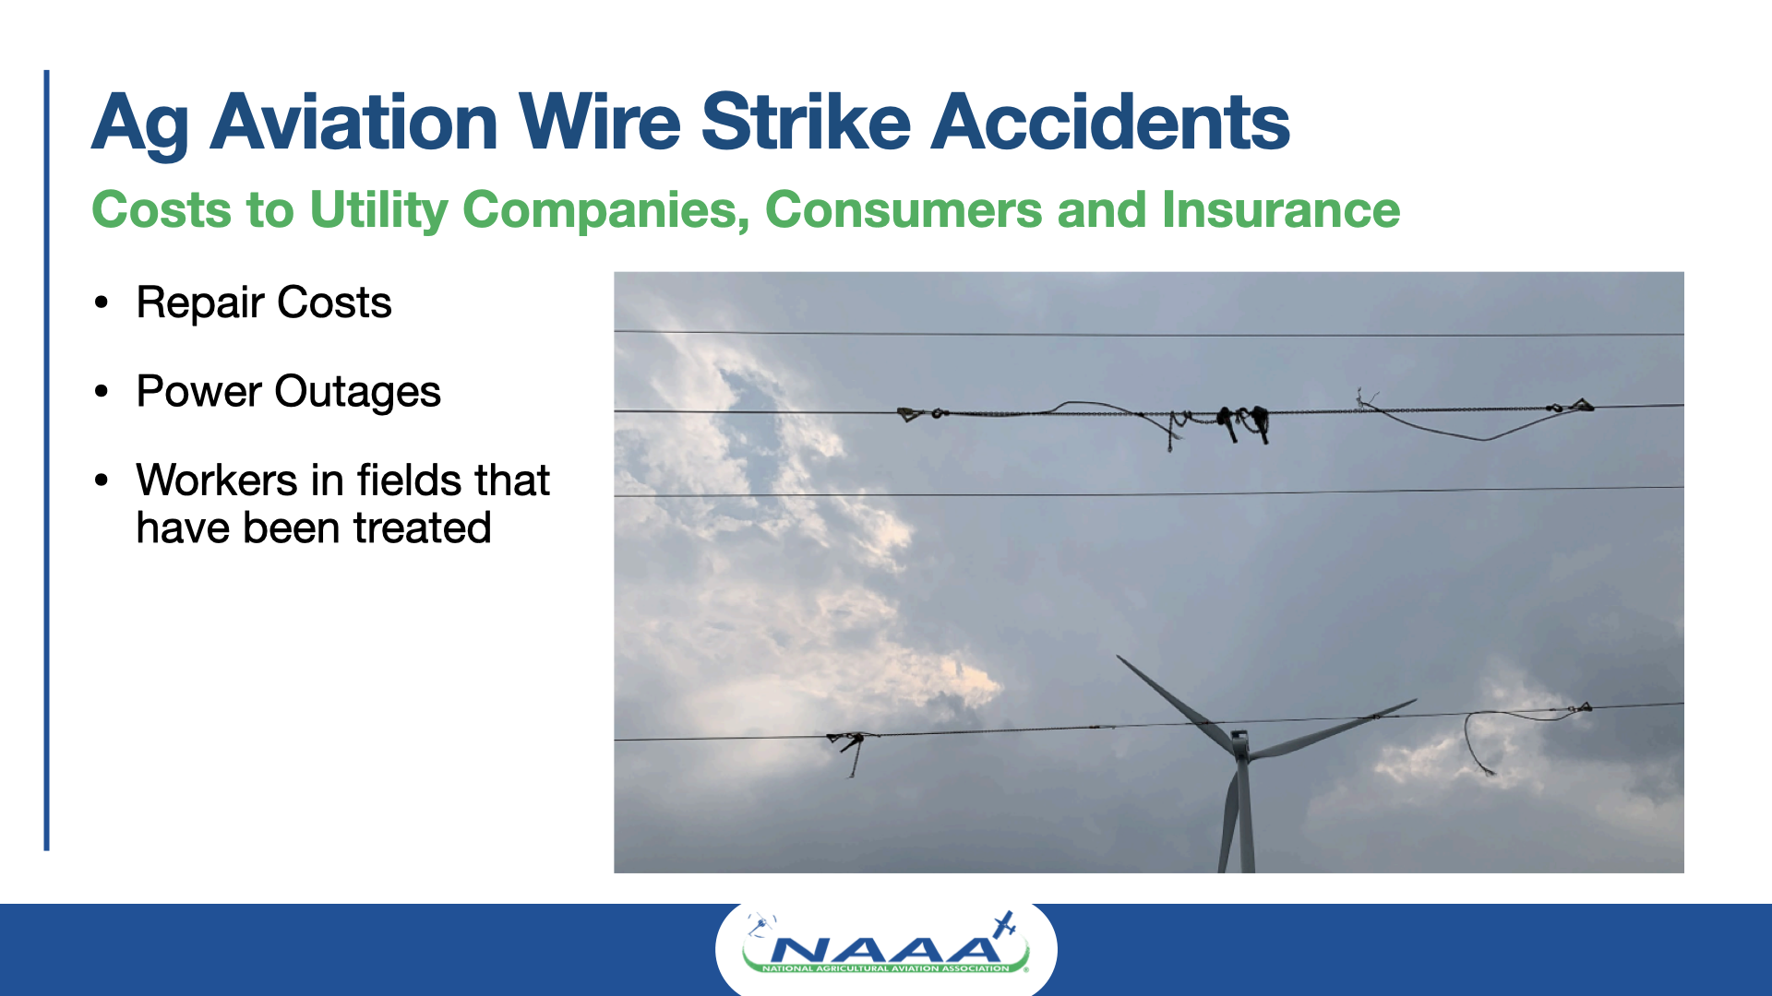

Slide 12
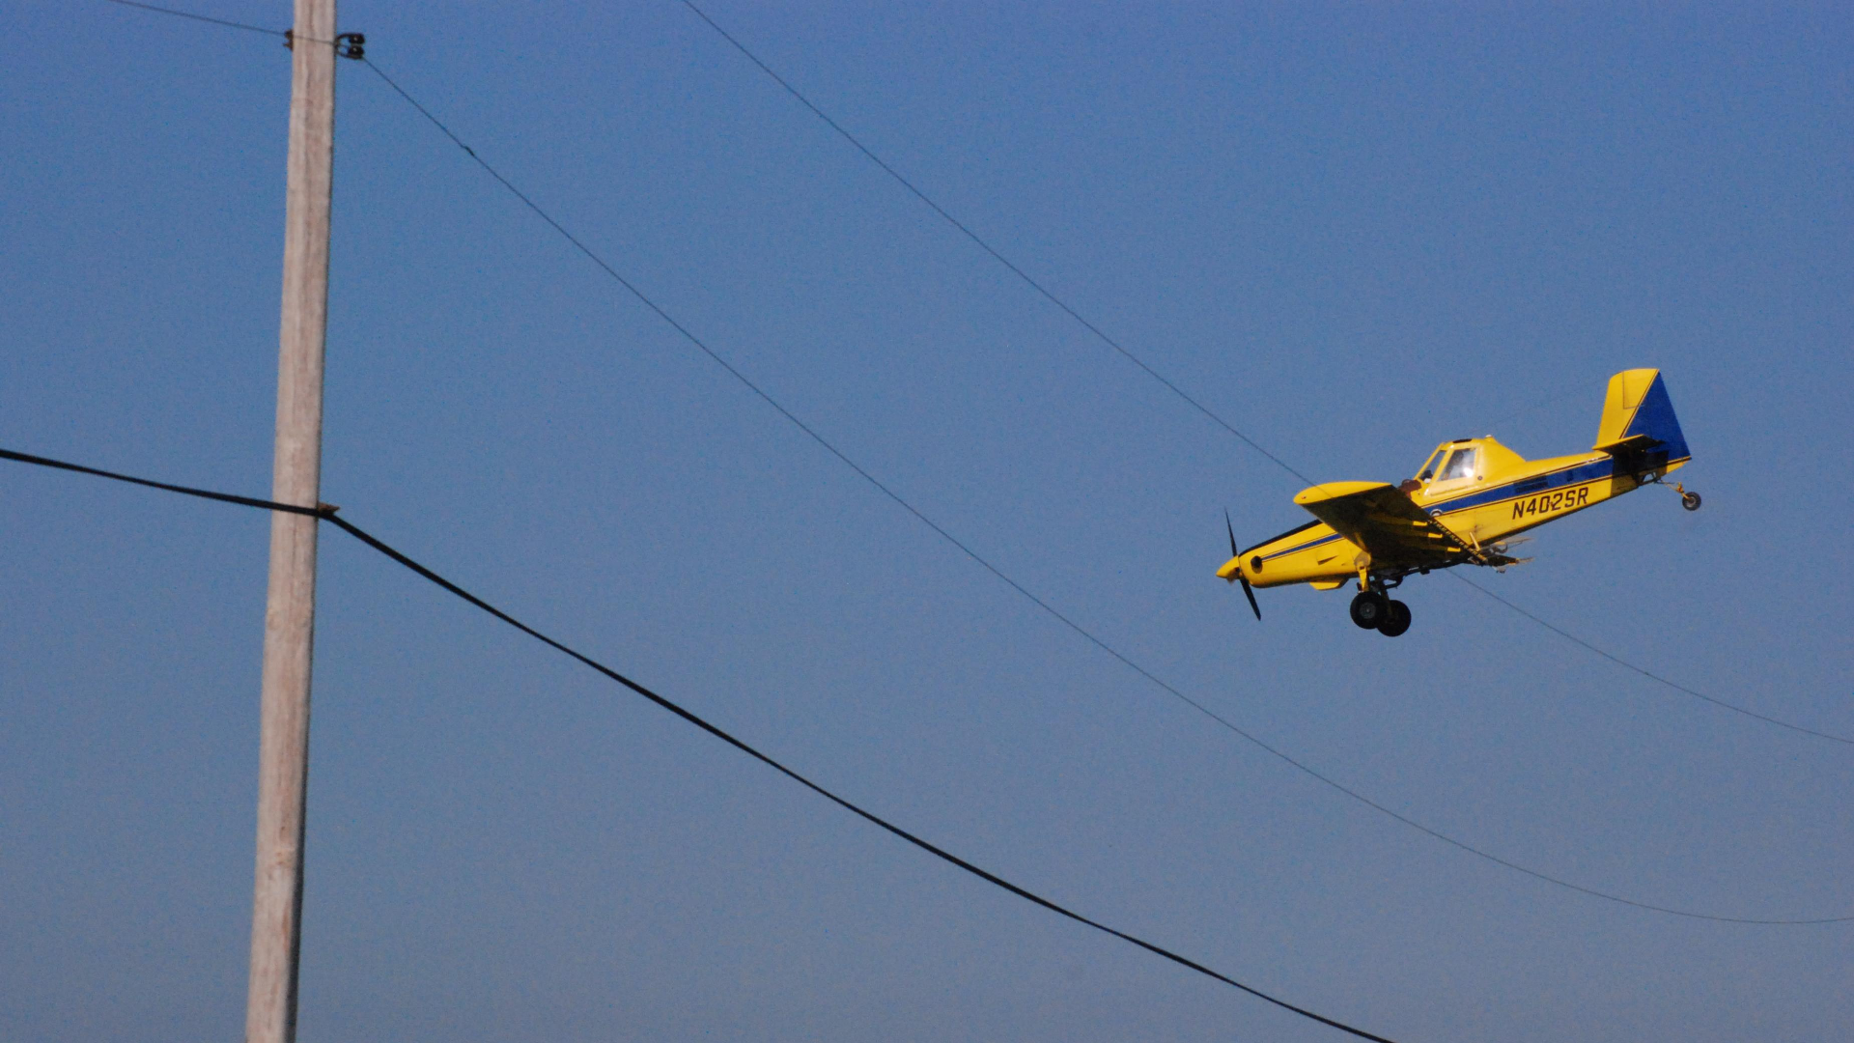
Wire Marking
Initiative
Identify
Remember

Slide 13
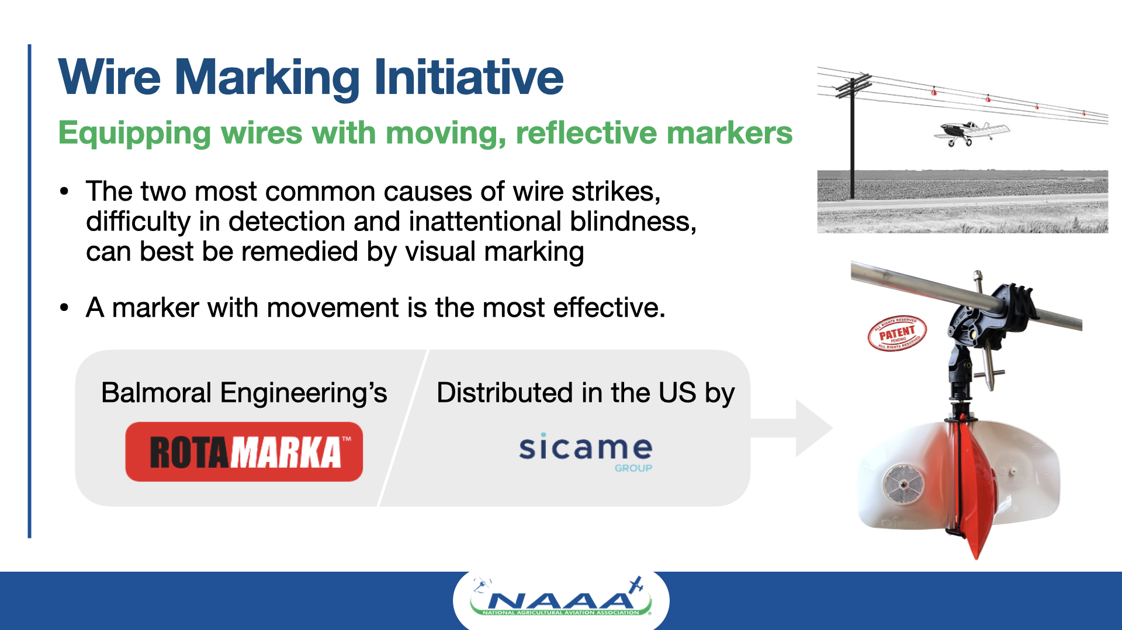

Slide 14
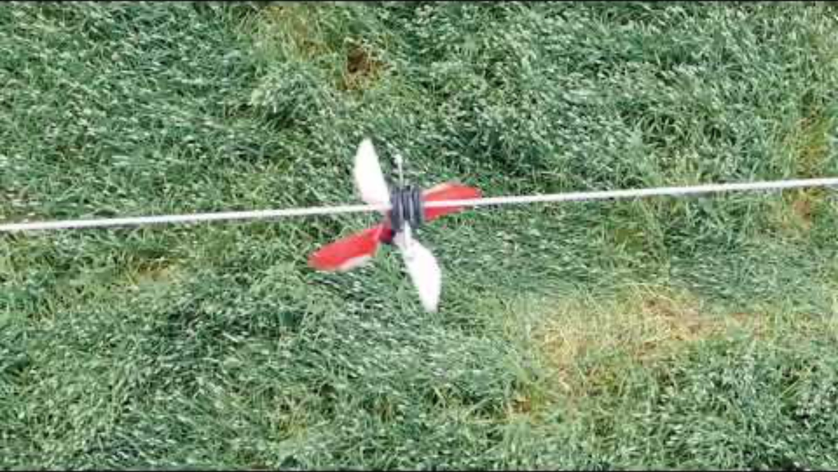

Slide 15
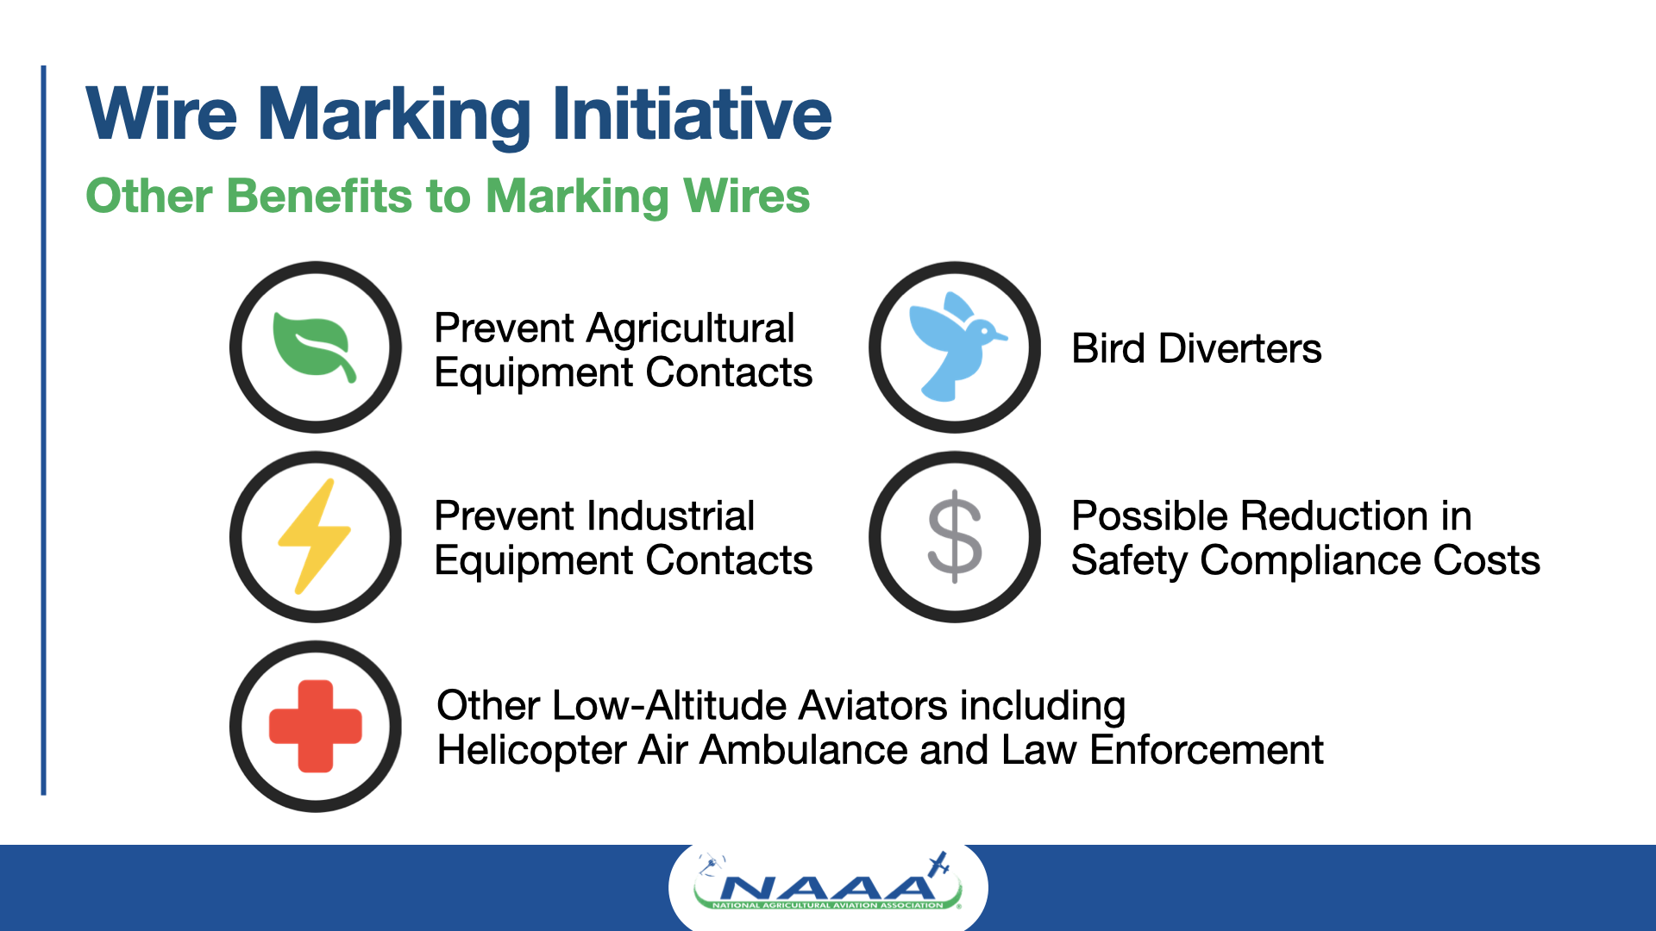

Slide 16
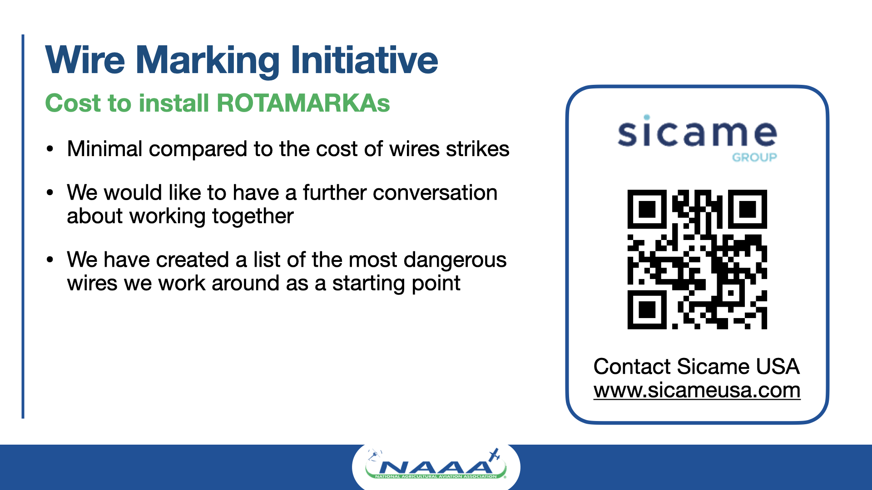

Slide 17
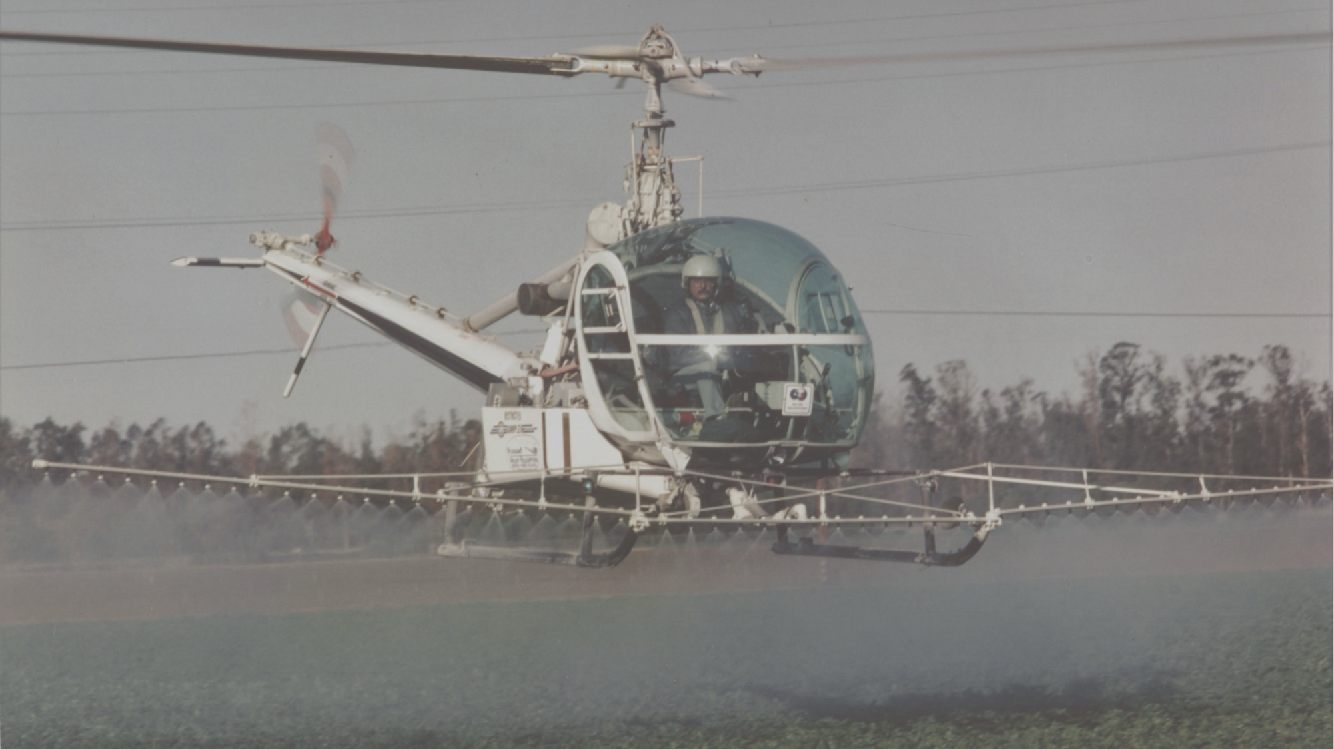
Agricultural Aviation and Wires
INSERT YOUR NAME AND CONTACT INFO HERE
Thank You for your Attention!

